Slide 1



BI Data Engineering Solution

Slide 2




About datakulture
Datakulture
Datakulture helps to spot the pattern and transform data into intelligent insights through cutting edge technologies and tools including augmented analytics. Datakulture is a division of Sedin Technologies.
Sedin
Sedin is an ISO certified IT Consulting & Software Services company established in 2006. With Sedin, clients are assured of a transparent business practice, cost effective solution, innovative & high-quality services. Their headquarter is in Chennai, India, and they also have offices in the United States, Canada, and Australia.

Slide 3
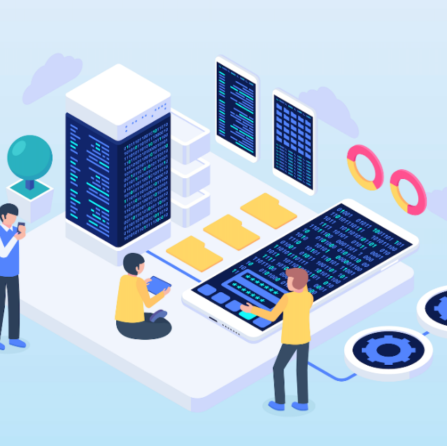

OUR approach
E
L
T
Data Extraction & Ingestion
Data Pipeline & Loading
Data Transformation & Normalization
Extraction of data from multiple on-premises, cloud databases it can be from ERP, CRM, flat files, and web APIs.
Loading of source data into a unified data warehouse/Lakehouse with full and incremental data loads
Data transformation and normalization across providers to enable standard formats, ensuring data integrity and quality, and applying business rules to make the data ready for analytics needs.

Slide 4
Modern BI Analytics - Logical Architecture
Data Sources
Cataloging & Search
Processing
ERP
Validate, Clean, Standardize, Normalize
Structured
data
Raw Zone
Consumption
CRM
Reporting tools
Ingestion
Cleaned Zone
Transform, Enrich
Interactive dashboards
Databases
Semi-structured data
Curated / Consumption Zone
Aggregated/ Data Mart
Ad hoc reports
External sources
OLAP cube
Security & Governance

Slide 5













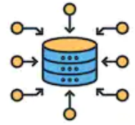




Solution Architecture – Using Python ETL Accelerator
CONSUMPTION
INGESTION
CATALOGING, GOVERNANCE & SEARCH
CONSUMPTION
PRESENTATION
for future AI/ML/DL purpose
Clickhouse / PostgreSQL DB Engine
STORAGE,PROCESSING
Extract
(Incremental Data Pull)
Cleansed Data
Curated Data
Raw Data
Data
Transformation
Data
Integration
Data
Harmonization
Business Rules
Other BI / Reporting tools, Web Application, UI / UX
Data Ingestion Accelerator Framework
SECURITY & MONITORING
ETL Audit Logging & Tracking
Scheduling & Orchestration through Apache Airflow

Slide 6





















ETL
Customer Registration.
Admin Approval
Customer Login
User Creation
Module Creation
Configuration Setting
Ingestion using Fabric Data Pipeline
Bronze
Silver
Gold
APIs
Bronze
Data Base
Flat Files
Extract
Transform
Load
Stagging
Raw Data
Filtered, Cleaned, Augmented
Apply Business Rules
Destination - Data Warehouse/ Lake
JSON Files
Cloud Storage
Data Sources
Scheduler, AI Enhancement
Data Lineage & Catalog
Data Governance
Monitoring & Maintenance
Analytics
Data Validation & Authentication, Visualization Report
Source Metadata Retrieval, Visual lineage mapping
Access Control & Data Security Setup
Job Scheduling, Logging, Error Handling

Slide 7


Customer Registration.
Admin Approval
Customer Login
User Creation
Configuration Setting
Domain Creation
Bronze
Ingestion by our ETL tool
Gold
Silver
Transform
Load
Data Base
Flat Files
APIs
Apply Business Rules
Filtered, Cleaned, Augmented
Raw Data
Stagging
Extract
JSON Files
Cloud Storage
Analytics
Scheduler, AI Enhancement
Data Sources
Data Lineage & Catalog
Monitoring & Maintenance
Data Validation & Authentication, Visualization Report
Access Control & Data Security Setup

Slide 8



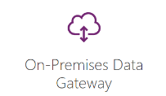




Solution Architecture – Using Microsoft Fabric
Sources
Workspace
Synapse Engineering
Synapse Engineering
Presentation
Analytics & reporting
Bronze Layer
Silver Layer
Gold Layer
RDBMS
Ingestion using Fabric Data Pipeline
Cleansed Data
Data
Transformation
Data
Integration
Data
Harmonization
Extract
Raw Data
Curated Data
Flat Files (Event Trigger)
ETL audit logging & tracking
Web APIs
Fabric Active Directory
Integration For
Authentication
Scheduling & Orchestration using Fabric Scheduler
One Lake

Slide 9
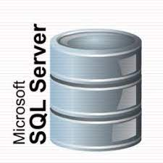



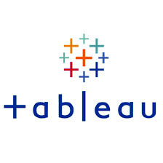

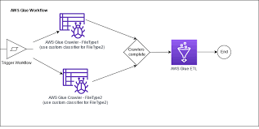
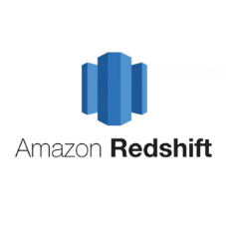




Solution Architecture – Using Amazon Stack
INGESTION
CATALOGING, GOVERNANCE & SEARCH
CONSUMPTION
PRESENTATION
Glue
Catalog
Access Control
Application DB (Replica)
STORAGE, PROCESSING
Extract
(Data Pull)
Web APIs
Raw Data in csv
Validate, Clean
Cleaned
Parquet, Partitioned
Normalize, Transform
Curated
Parquet, Partitioned
STORAGE – in aws S3 Bucket PROCESSING – thro’ aws Glue
Glue Loader
Flat Files (Event Trigger)
AWS SFTP
Other BI / Reporting tools, Web Application, UI / UX
SECURITY & MONITORING
AWS CloudWatch
AWS IAM

Slide 10
Our Data Ingestion – process flow
Connect sources in parallel
01
Fetch entries from control tables
and call various source handlers in parallel
Pre-process
02
Call pre-process and log audit entries
Staging
03
Move data to multiple staging zones
Auditing & Error Handling
04
Call post process to ensure ingestion is complete

Slide 11
Our Data Ingestion – advantage
Parallel Processing - Multithreading
Metadata Driven
Auditing & Error Handling
Secured & high performance even at multiple data sources
Data integration through information about the data sources and destinations
Data quality and integrity by ensuring accountability, detecting and resolving issues
Scale up /Scale out process
Dynamic Schema support
Modular & Easy Maintenance
Flexible data modeling and seamless integration of varying data structures by allowing the schema to evolve and adapt to changes in the data sources

Slide 12
Our Delivery Approach
Governance
Sprint
planning
Issue Tracking
Issue Resolution
Reporting
Sprint
sign off
Development
2 weeks
sprint
Agile Development
Incremental development & delivery mechanism
Phased movement to production
Continuous feedback for improvements
Phased transition to support
Demo
sessions
Test
& deploy

Slide 13
A DIVISION OF SEDIN TECHNOLOGIES

